Slide 1



Plant Disease Detection
using Deep Learning
Internship ID: INTERNSHIP_17513641056863b20937d78

Slide 2

Learning Objectives
To design a deep learning model for accurate plant disease classification.
To classify 12 types of plant diseases from leaf images.
To use MobileNetV2 for efficient and lightweight detection.
To evaluate performance using accuracy, loss, and confusion matrix.
GOAL
Source :
www.freepik.com/

Slide 3
Tools and Technology used
Programming Language: Python
Libraries: TensorFlow / Keras, NumPy, Matplotlib, OpenCV, scikit-learn
Model: MobileNetV2 (Transfer Learning)
IDE: Jupyter Notebook (VS Code)
Dataset: ~20,000 images (12 classes of plant diseases)

Slide 4
Methodology
Collected dataset of 20,000+ images (12 classes – Train: 1000, Validation: 500, Test: 300).
Preprocessed images (resize to 224×224, normalization, augmentation).
Built model using MobileNetV2 with transfer learning.
Trained and validated model with tuned hyperparameters.
Evaluated using accuracy, loss curves, confusion matrix & classification report.
Tested on 300 unseen images for final predictions.

Slide 5
Problem Statement:
Plant diseases are a major cause of reduced crop yield.
Farmers often face financial losses due to late detection.
Manual identification requires expert knowledge and time.
Early symptoms are difficult to detect with naked eyes.
Existing solutions are not scalable for multiple disease types.
A need exists for an automated, accurate, and fast detection system.

Slide 6
Solution:
Designed a lightweight MobileNetV2 model suitable for real-time use.
Automated classification of 12 plant disease categories.
Achieves fast training and high accuracy even with limited dataset.
Provides early and reliable detection of plant diseases.
Reduces dependency on manual inspection and expert knowledge.
Scalable for future deployment in mobile or web-based platforms for farmers.

Slide 7
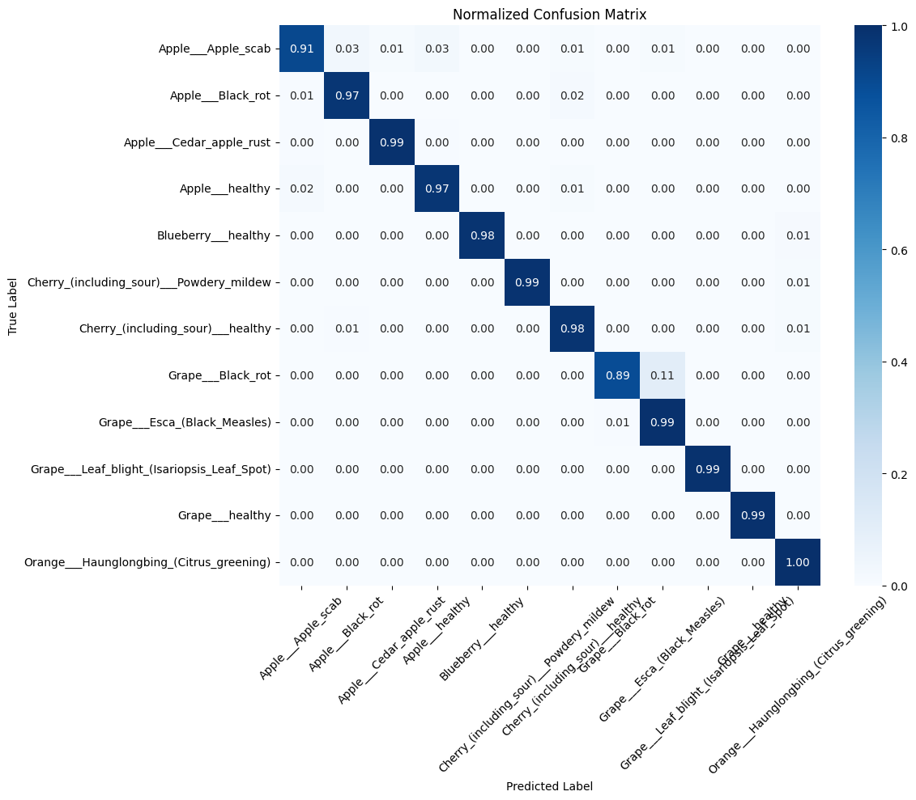
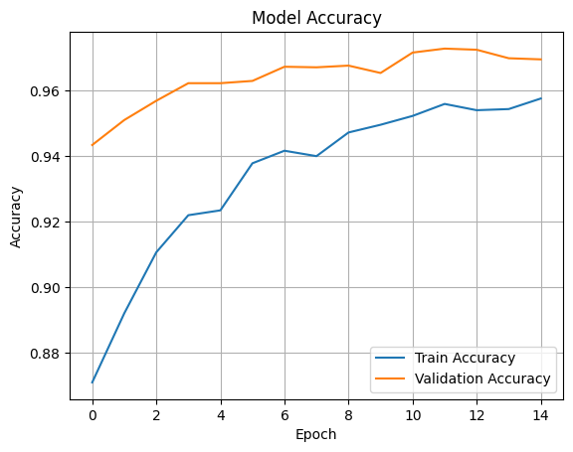
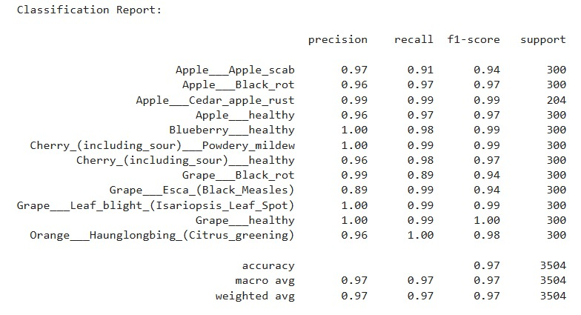
Screenshot of Output:

Slide 8
Conclusion:
Successfully implemented a MobileNetV2-based model for plant disease detection.
Achieved promising accuracy on test dataset (300 images per class).
The model is efficient, lightweight, and suitable for real-time use.
Future Work: Extend dataset size, improve model generalization, and deploy as a mobile/web app for farmers.

